Slide 1
PART 2
RELATIONAL DATABASES

Slide 2
Chapter 6
Formal Relational Query Language

Slide 3
Main Parts in Chapter 6
Categories of relational operations
relational operations/arithmetic
relational calculus
relational algebra
tuple relational calculus
domain relational calculus
  tuple relational calculus (元组关系演算,§6.2)
  domain relational calculus (域关系演算, §6.3)

Slide 4
Main Parts in Chapter 6
Relational algebra
  fundamental operations (§6.1.1-2)
  additional operations (§6.1.3)
  extended operations (§6.1.4)

Slide 5

Fig. Schema Diagram

Slide 6
用处
SQL语言的理论基础
实际DBMS环境下，观察SQL语句的查询执行计划——表示为关系代数操作，分析、判断、优化SQL语句
  提高SQL语句执行效率，保证数据库系统性能
  — 数据库系统维护优化
E.g. 观察select语句的查询执行计划不同，比较同一查询的不同实现方式
Notes:
查询处理过程：首先要将SQL查询表达式转化为关系代数表达式，并在此基础上进行查询优化，获取最优的查询执行计划进行执行。
同一个查询，可转化为不同的关系代数表达式，而且每个关系操作又可能对应不同的算法，因此对应不同的查询执行计划。需要针对这些关系代数表达式，
进行分析，判断和优化SQL语句，提高执行效率，优化系统性能。

Slide 7
6.1 Relational Algebra
6.1.1 Fundamental Operations
Six basic operators
  select: σ
  project: ∏
  union: ∪
  set difference: –
  Cartesian product: x
  rename: ρ
The operators take one or two relations as inputs and produce a new relation as a result.

Slide 8
Select Operation
Notation: σ _{p}(r)
p is called the selection predicate
Defined as:
σ_{p}(r) = {t | t ∈ r and p(t)}
Where p is a formula in propositional calculus consisting of terms connected by : ∧ (and), ∨ (or), ¬ (not)
Each term is one of:
<attribute> op <attribute> or <constant>
where op is one of: =, ≠, >, ≥. <. ≤
Example of selection: σ _{dept_name=“Physics”}(instructor)
SQL statement
Select *
From r
Where P

Slide 9
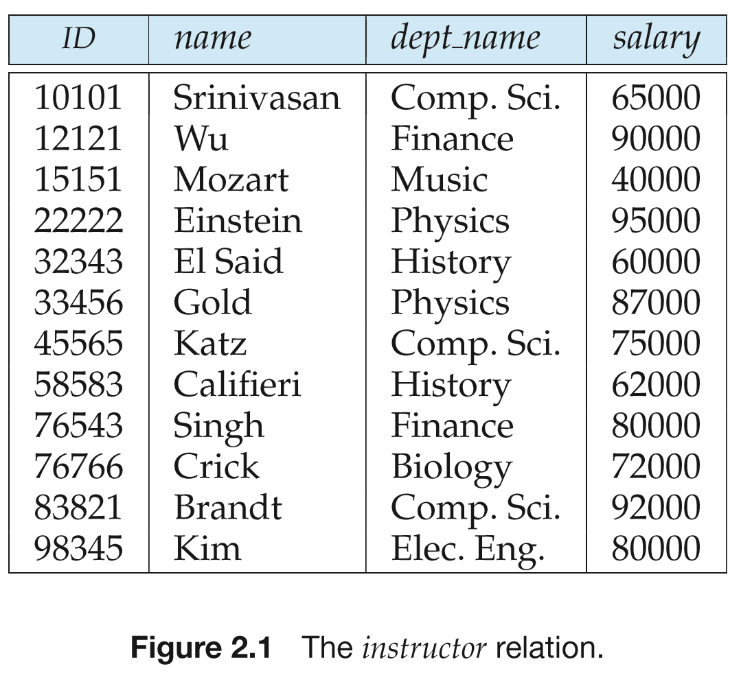
Example of selection: σ _{dept_name=“Physics”}(instructor)

Slide 10

Project Operation
SQL statement
Select A₁, A₂ , A_{k}
From r
Notation:
where A₁, A₂ are attribute names and r is a relation name.
The result is defined as the relation of k columns obtained by erasing the columns that are not listed
Duplicate rows removed from result, since relations are sets
Example: To eliminate the dept_name attribute of instructor
∏_{ID, name, salary} (instructor)

Slide 11
Composition Operations
Several relational algebra operations can be composed together into a relational algebra expression
E.g.2. ∏_{Id, name, salary}(σ _{dept_name=“Physic’} (instructor))

Slide 12
Union Operation
Notation: r ∪ s
Defined as:
r ∪ s = {t | t ∈ r or t ∈ s}
For r ∪ s to be valid.
1. r, s must have the same arity (same number of attributes)
2. The attribute domains must be compatible (example: 2nd column of r deals with the same type of values as does the 2nd column of s)
SQL statement
r Union s
r Union All s

Slide 13
Union Operation
Example: to find all courses taught in the Fall 2009 semester, or in the Spring 2010 semester, or in both
∏_{course_id} (σ _{semester=“Fall” Λ year=2009} (section)) ∪
∏_{course_id} (σ _{semester=“Spring” Λ year=2010} (section))

Slide 14
Set Difference Operation
Notation r – s
Defined as:
r – s = {t | t ∈ r and t ∉ s}
Set differences must be taken between compatible relations.
  r and s must have the same arity
  attribute domains of r and s must be compatible
Note: r ∩ s = r – (r – s)
SQL statement
r Except s

Slide 15
Set Difference Operation
Example: to find all courses taught in the Fall 2009 semester, but not in the Spring 2010 semester
∏_{course_id} (σ _{semester=“Fall” Λ year=2009} (section)) −
∏_{course_id} (σ _{semester=“Spring” Λ year=2010} (section))

Slide 16
Cartesian-Product Operation
Notation r ╳ s
Defined as:
r ╳ s = {t | t = t₁ t₂ and t₁∈ r and t₂ ∈ s }
Assume that attributes of r(R) and s(S) are disjoint. (That is, R ∩ S = ∅).
If attributes of r(R) and s(S) are not disjoint, then renaming must be used.

Slide 17
Cartesian-Product
E.g.1
SQL Statement:
Select *
From r, s
Cartesian-product operation on relation r and s
r ╳ s = {t | t = t₁ t₂ and t₁∈ r and t₂ ∈ s }
A
B
C
D
E
A
B
C
D
E
t₁
α
β
1
2
α
β
β
γ
10
10
20
10
a
a
b
b
α
α
α
α
β
β
β
β
1
1
1
1
2
2
2
2
α
β
β
γ
α
β
β
γ
10
10
20
10
10
10
20
10
a
a
b
b
a
a
b
b
t₂
t
r
s
Fig.6.05
r ╳ s

Slide 18
Cartesian-Product
For relation r(R) and s(S), r ╳ s is a relation whose schema is R’ , which is the concatenation （串联）of R and S
  R (A₁, A₂, …, A_{m}), S(B₁, B₂, …, B_{n})
  R’ (A₁, A₂, …, A_{m}, B₁, B₂, …, B_{n})
  for t ∈ r ╳ s , there are t₁ ∈ r and t₂ ∈ s, such that
  t[R] = t₁[R]
  t[S] = t₂[S]
  assume that attributes of r(R) and s(S) are disjoint. i.e. {A₁, A₂, …, A_{m}} ∩ {B₁, B₂, …, B_{n}} = ∅
  if attributes of r(R) and s(S) are not disjoint, then renaming must be used.

Slide 19
Fundamental Operations vs Select statement in SQL
A typical SQL query has the form
select A₁, A₂, ..., A_{n}
from r₁, r₂, ..., r_{m}
where P
  A_{i}s represent attributes
  r_{i}s represent relations
  P is a predicate
Equivalent to the relational algebra expression
∏ _{A1, A2, ..., An}(σ_{P} (r₁ x r₂ x ... x r_{m}))

Slide 20
Rename Operation
The rename operation on relation r or relational algebra expression E
ρ _{x} (r) , ρ _{x} (E)
  renaming r or E as X
If a relational-algebra expression E has arity n, then
ρ_{x} _{(A1, A2, …, An)} (E)
returns the result of expression E under the name X, and with the attributes renamed to A1, A2, …., An
E.g. ρ_{s} _{(A1, A2, …, An)} ( r (B₁, B₂, …, B_{n})) = s (A₁, A₂, …, A_{n})

Slide 21
Rename Operation
– An Example
Find the highest salary in the univsersity
Principle
  /*将对一个关系instructor中同一个属性salary的不同取值的比较转换为利用换名操作、迪卡尔乘积和选择操作对关系instructor和它的副本ρ _{d} (instructor)在同一属性salary上取值的比较, refer to Fig.6.0.6
Step1.
  instructor ╳ ρ _{d} (instructor)
Step2. all tuples that have non-largest salary values in instructor relation:
σ _{instructor.salary < d.salary} (instructor ╳ ρ _{d} (instructor))

Slide 22
Rename Operation
– An Example (cont.)
ins.ID | ins.name | ins.salary
120005 | Zhang | 1000
130007 | Wang | 2000
198032 | Li | 3000
d.ID | d.name | d.salary
120005 | Zhang | 1000
130007 | Wang | 2000
198032 | Li | 3000
(a) instructor
(b) d =
ρ _{d} (instructor)
Fig relation instructor and d

Slide 23
instructor
d
ins.ID | ins.name | ins.salary | d.ID | d.name | d.salary
120005 | Zhang | 1000 | 120005 | Zhang | 1000
120005 | Zhang | 1000 | 130007 | Wang | 2000
120005 | Zhang | 1000 | 198032 | Li | 3000
130007 | Wang | 2000 | 120005 | Zhang | 1000
130007 | Wang | 2000 | 130007 | Wang | 2000
130007 | Wang | 2000 | 198032 | Li | 3000
198032 | Li | 3000 | 120005 | Zhang | 1000
198032 | Li | 3000 | 130007 | Wang | 2000
198032 | Li | 3000 | 198032 | Li | 3000
Fig. instructor ╳ ρ _{d} (instructor)

Slide 24
Rename Operation
– An Example (cont.)
Step3. all non-largest salary values in relation instructor
  ∏_{instructor.salary}(
  σ _{instructor.salary < d. salary} (instructor ╳ ρ _{d} (instructor))
  the result is {1000, 2000}
Step4. All largest balance values in relation account
  ∏_{salary} (instructor) —
  ∏ _{instructor.salary} (
  σ _{instructor.salary < d. salary} (instructor ╳ ρ _{d} (instructor))
  the result is {1000, 2000, 3000} — {1000, 2000} = {3000}

Slide 25
Rename Operation
– An Example (cont.)
This query can also be solved by Select statement in SQL, by means of
  tuple variables
  set comparison
  aggregate function max

Slide 26
6.1.2 Formal Definition of Relational Algebra
Relational algebra expression E is defined as follows
  a basic expression is
    a relation r in the database, or
    a constant relation C= {c₁, c₂, .., c_{n}}, which is written by listing its tuples in the relation
  a general expression is defined as:
  if E₁ and E₂ are relational algebra expressions, then
    E₁∪ E₂
    E₁— E₂
    E₁ ╳ E₂

Slide 27
Formal Definition of Relational Algebra (cont.)
    σ_{p} (E₁)
    ∏s (E₁),
    ρ_{x} (E₁ )
    are all relational algebra expressions

Slide 28
6.1.3 Additional Operations
Additional operations
  ∩, set-intersection（集合交）
  ∞, natural-join （自然、外连接）
  ←，assignment（赋值）
With respect to querying powers, additional operations are equivalent with fundamental operations, i.e. can be replaced (or re-represented ) by the six basic operations
  an additional operation can be replaced/re-represented by basic operations
  additional operations simplify representations of queries

Slide 29
6.1.3.1 The Set-Intersection Operation
For relation r and s, set-intersection operation on r and s is defined as
r ∩ s ={ t | t ∈ r and t ∈ s }
  r, s have the same arity
  attributes of r and s are compatible
r ∩ s = r - (r - s)
SQL statement
  intersect

Slide 30
6.1.3.2 The Natural-join Operation
E.g.1
A
B
C
D
B
D
E
(1)
α
β
γ
α
δ
1
2
4
1
2
α
γ
β
γ
β
a
a
b
a
b
(1)
1
3
1
2
3
a
a
a
b
b
α
β
γ
δ
∈
r
s
A
B
C
D
E
(1)
α
α
α
α
δ
1
1
1
1
2
α
α
γ
γ
β
a
a
a
a
b
α
γ
α
γ
δ
r s
Fig.6.07

Slide 31
Natural-join (cont.)
For relations r(R) and s(S), assuming R∩S = {A₁, A₂, …, A_{n} }, the natural join of r and s, denoted by r s , is a relation on schema R∪S,
r s =
∏_{R∪S} (σr.A1=s.A1∧r.A2=s.A2 ∧…∧r.An=s.An ( r ╳ s ))
E.g.1 (cont.)
R = (A, B, C, D), S = (B, D , E ), r(R) and s(S),
  r s =
  ∏_{r.A, r.B, r.C, r.D, s.E} (σ_{r.B = s.B ∧ r.D = s.D} (r ╳ s))
  defined on the schema (A, B, C, D, E)

Slide 32
2.3.2 The Natural-join Operation
(cont.)
Natural-join operation combine σ and ╳ on some relations into one operation
  to improve execution efficiency of query
  for more details, refer to Query Optimization in Chapter13

Slide 33
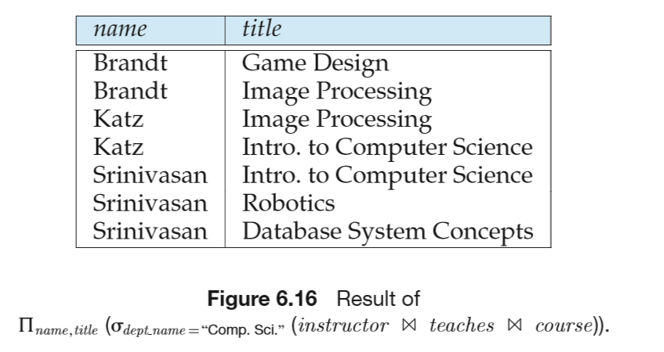
Natural-join
E.g.2 Find the names of all instructors in the Comp.Sci department together with the course titles of all courses the instructors teach

Slide 34
Natural-join
Properties of natural join
  r ( s t ) =( r s ) t
  if R ∩S = Φ, then r(R) s(S) = r(R) ╳ s(S)

Slide 35
6.1.3.3 The Assignment Operation
Assign (←) relation algebra expression E to a relational variable var_r, i.e. denoting E as var_r.
var_r ← E
The assignment operation (←) provides a convenient way to express complex queries
E.g. Write r ÷ s as
temp1 ← ∏_{R-S} (r)
temp2 ← ∏_{R-S} ((temp1 × s) – ∏_{R-S,S} (r))
result = temp1 – temp2

Slide 36
Assignment (cont.)
Assignment must always be made to a temporary relation variable
  assignments to permanent relations constitute a database modification

Slide 37
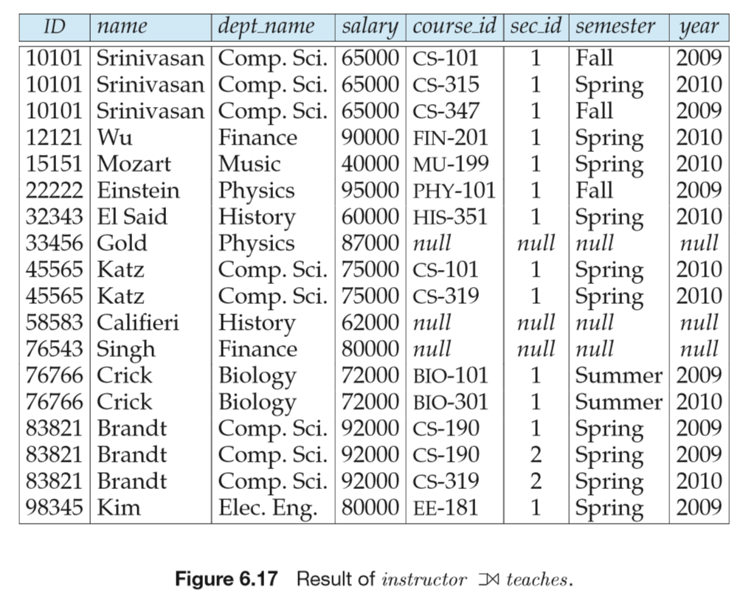
6.1.3.4 Outer join
The outer join operation is an extension of the join operation to deal with missing information

Slide 38
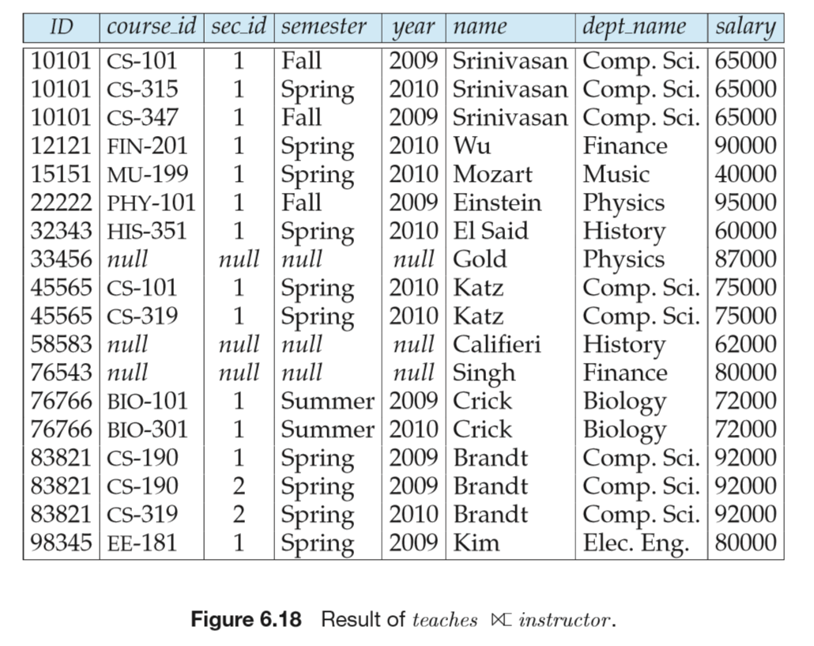
Outer join

Slide 39
Fig. Schema Diagram

Slide 40
§6.1.4 Extended Relational Algebra Operations
Generalized project, aggregate functions, outer join
  these operations extends query powers of basic and additive relational algebra operations
6.1.4.1 Generalized Project (一般化/扩展投影操作)
Generalized project extends the projection operation by allowing arithmetic functions to be used in the projection list.
∏ _{F1, F2, …, Fn}(E),
where
  E is any relational-algebra expression
  each of F₁, F₂, …, F_{n} are are arithmetic expressions involving constants and attributes in the schema of E.

Slide 41
2.4.1 Generalized Project (cont.)
  involving arithmetic operation on values of different attributes in one relation,
  e.g. E.A_{i} — E.A_{j}
E.g.
∏_{ID,} _{name, department_name,} _{salary/12} (instructor)

Slide 42
6.1.4.2 Aggregation Function
Aggregation functions
  mapping of a collection of attribute values in a relation r into a single value, i.e. attribute domains → domain
  avg: average value
  min: minimum value
  max: maximum value
  sum: sum of values
  count: number of values

Slide 43
Aggregate Functions in SQL
group by subclause and aggregate function
Select { A₁, A₂, ., A_{i} ,} ag_fun(A_{i+1}),…, ag_fun(A_{i+k})
From r₁, r₂, ..., r_{m}
Where P1
{ Group by A₁, A₂, ., A_{i}
{ having P2 } }

Slide 44
Aggregation Function (cont.)
Aggregate operation in relational algebra
_{G1, G2, …, Gn} g _{F1( A1), F2( A2),…, Fm( Am)} (E)
  E is any relational-algebra expression
  G1, G2 …, Gn is a list of attributes on which to group (may be empty)
    a list of attributes in E on which to group (分组) , i.e. tuples in E are classified into several groups E₁, E₂, …, E_{n}, each group E_{i} is a subset of E, and tuples in each group E_{i} have the same values for G1,G2,…,Gn
  if G1, G2,…,Gn do not appears, aggregations are conducted on all tuples in E, that is, E are not classified into groups

Slide 45
§2.2.2 Aggregation Function (cont.)
  each A_{i} is an attribute on which to conduct aggregation functions F_{i}
    also the attribute names for aggregation results
  aggregation functions F_{i} , e.g. avg, count, min, max, sum
  computing procedure
    separating E into groups on the basis of G1, G2 …, Gn
    computing F₁, F₂,…, F_{n} on each group, and return computing results denoted as A₁, A₂, …, A_{n}

Slide 46
